Slide 1



Pharmaceutical Data
View in Power BI
Last data refresh:
11/10/2024 18:32:00 UTC
Downloaded at:
14/10/2024 20:43:21 UTC

Slide 2
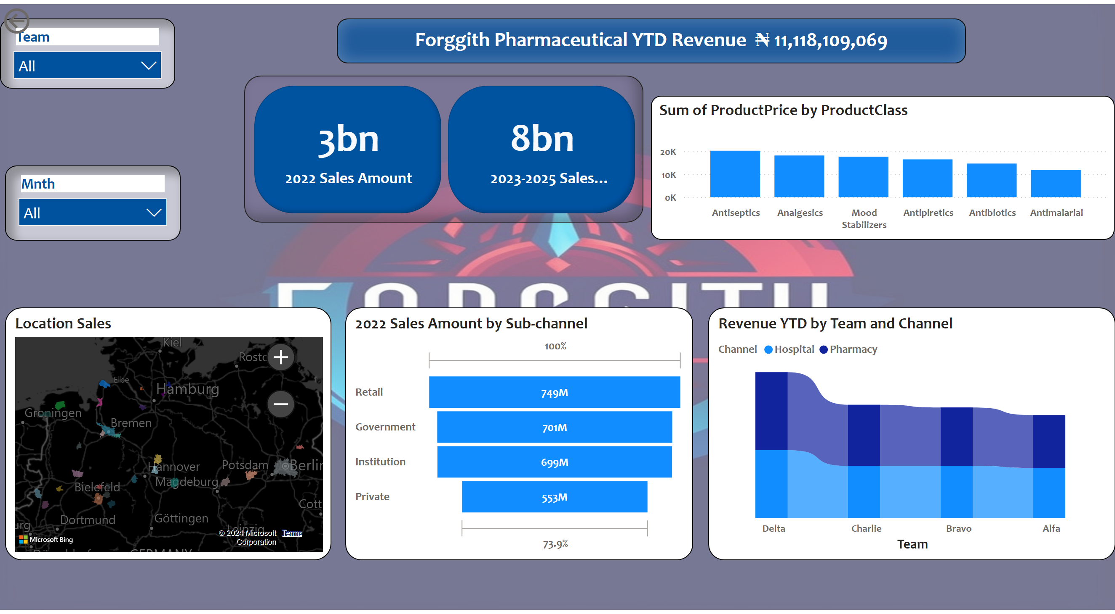
Sales Performance Overview
Notes:
slicer
No alt text provided
ribbonChart
No alt text provided
cardVisual
No alt text provided
textbox
No alt text provided
actionButton
No alt text provided
funnel
No alt text provided
lineStackedColumnComboChart
No alt text provided
slicer
No alt text provided
Location Sales
No alt text provided

